Slide 1


CEF440:INTERNET AND MOBILE PROGRAMMING
PROJECT:
Biometric Student Attendance
Presented by: Group 19
TASK 4:
System Modeling
Instructor: Dr NKEMENI VALERY

Slide 2
CONTENT
01
Introduction
Context diagram
02
.
03
Use case diagram
04
Class diagram
05
Sequence diagram
06
Deployment diagram
07
Conclusion

Slide 3
1 INTRODUCTION
System modelling is the process of creating an abstract representation of a system to better understand, analyse, and communicate
its structure, behaviour and functioning

Slide 4
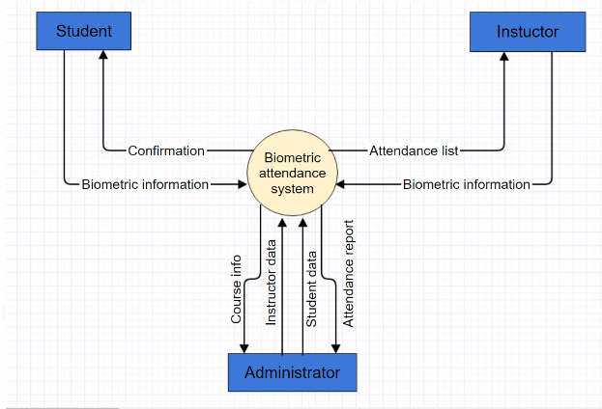
2 CONTEXT DIAGRAM

Slide 5
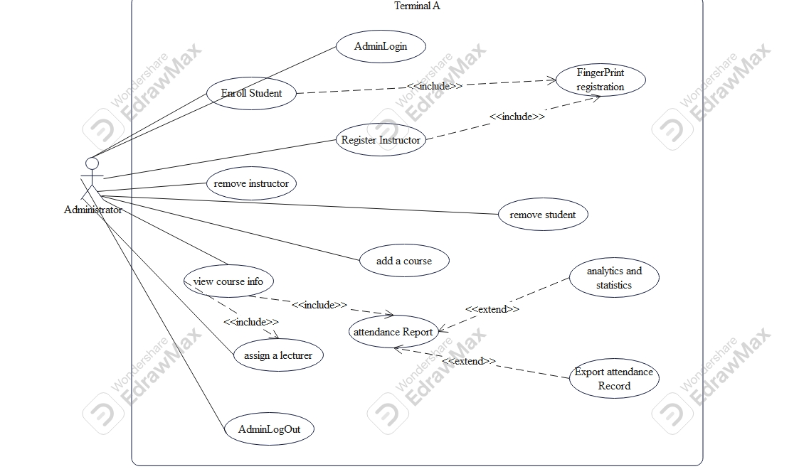
3.1 USE CASE DIAGRAM(1/3)

Slide 6
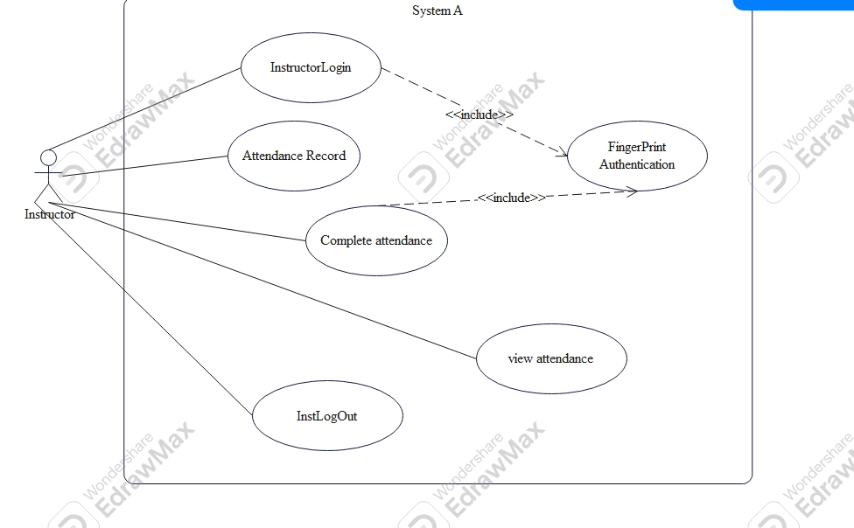
3.2 USE CASE DIAGRAM(2/3)

Slide 7
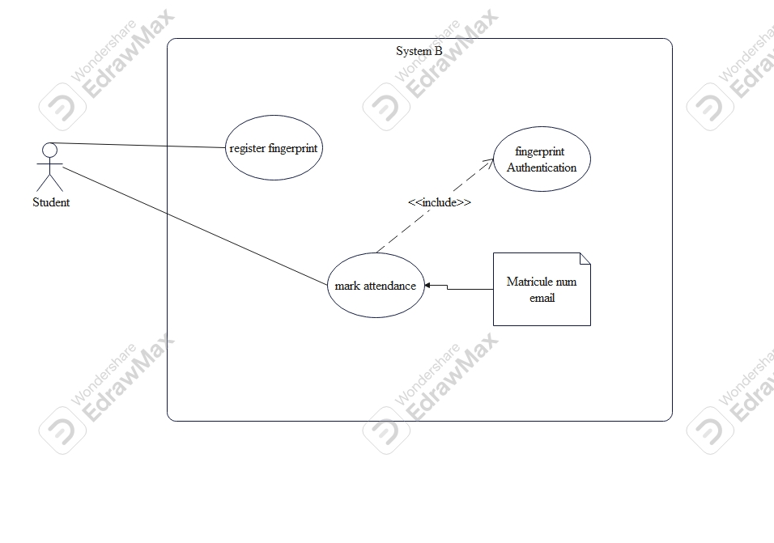
3.3 USE CASE DIAGRAM(3/3)

Slide 8
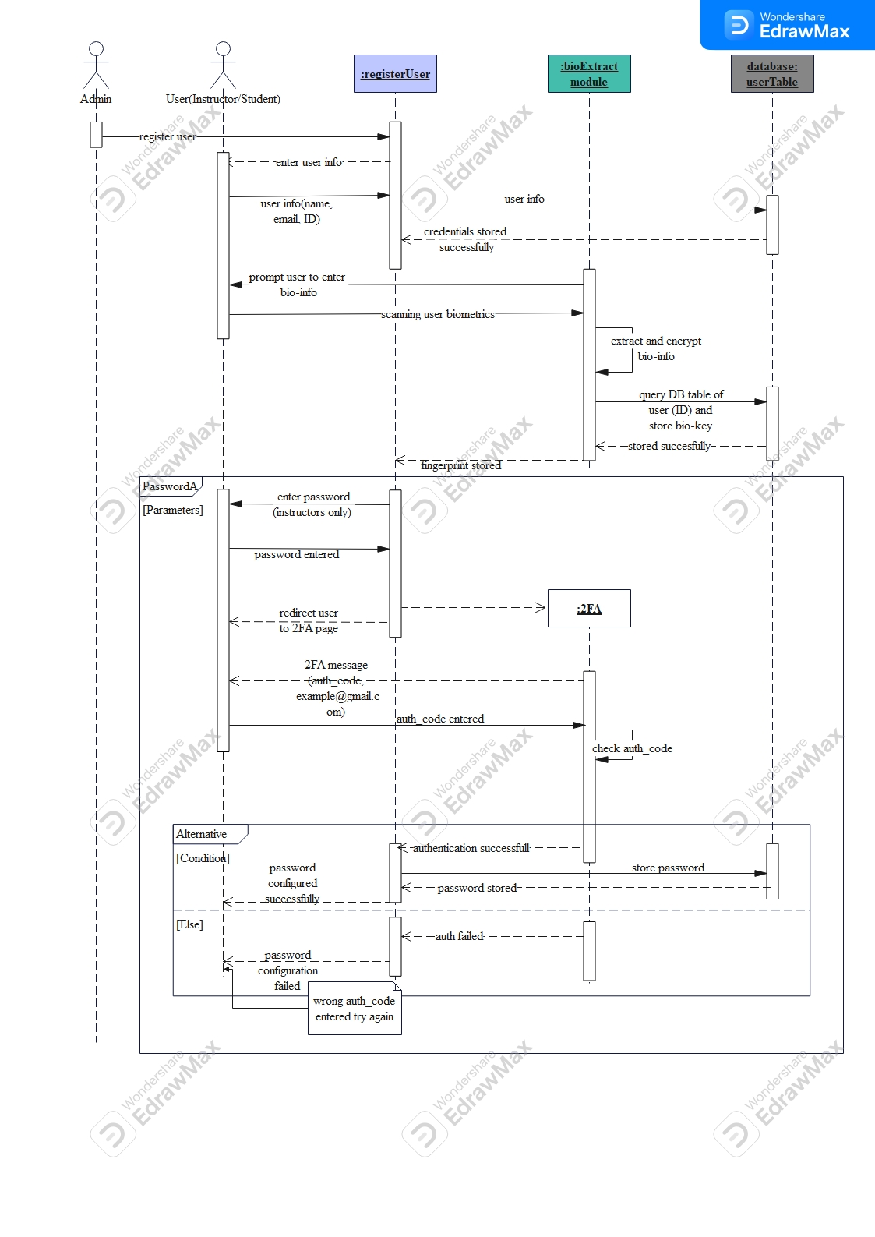
4.1 SEQUENCE DIAGRAM(1/3)

Slide 9
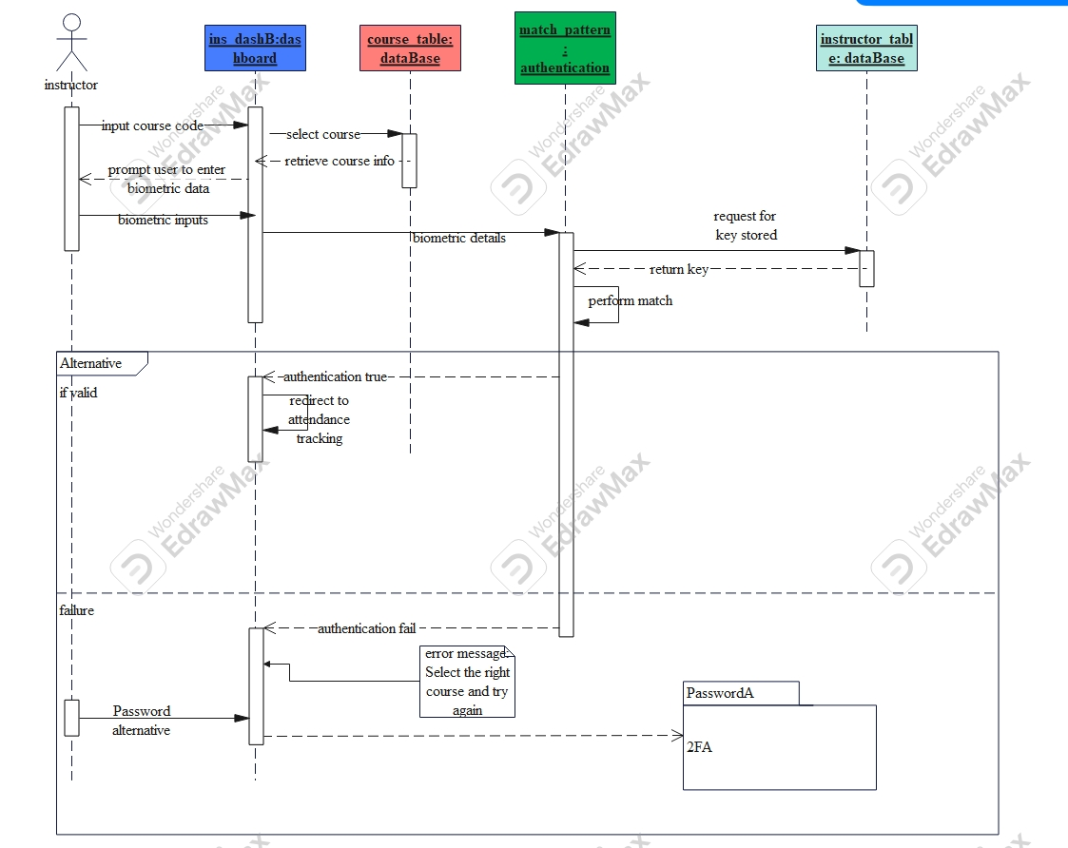
4.2 SEQUENCE DIAGRAM(2/3)

Slide 10
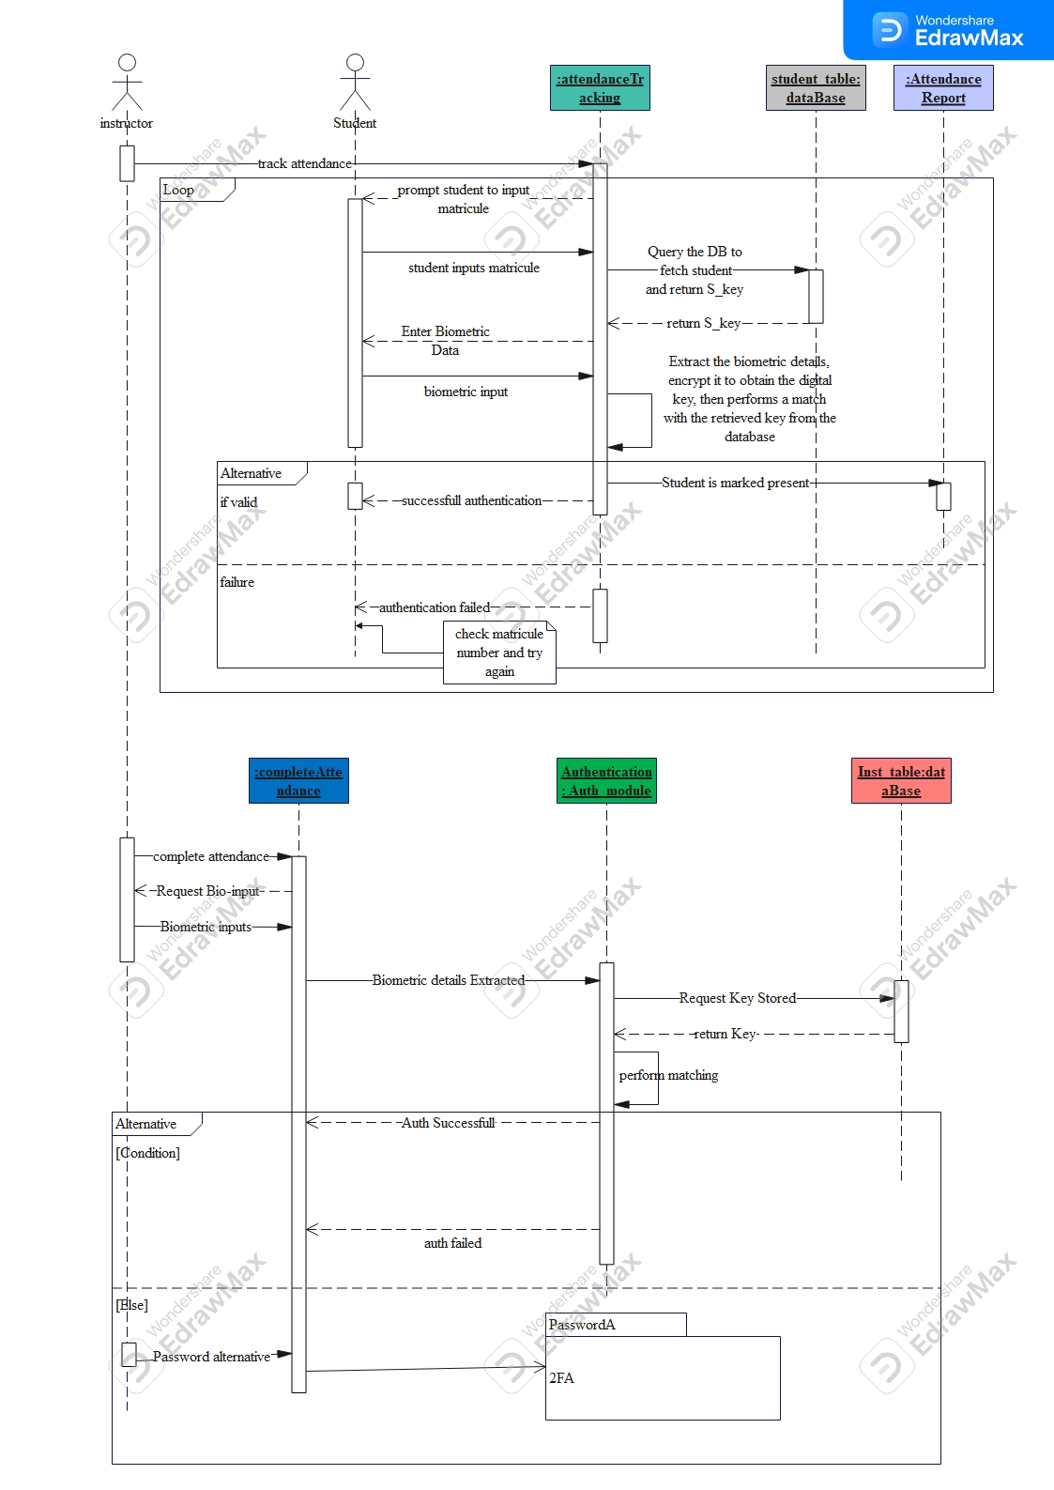
4.3 SEQUENCE DIAGRAM(3/3)

Slide 11
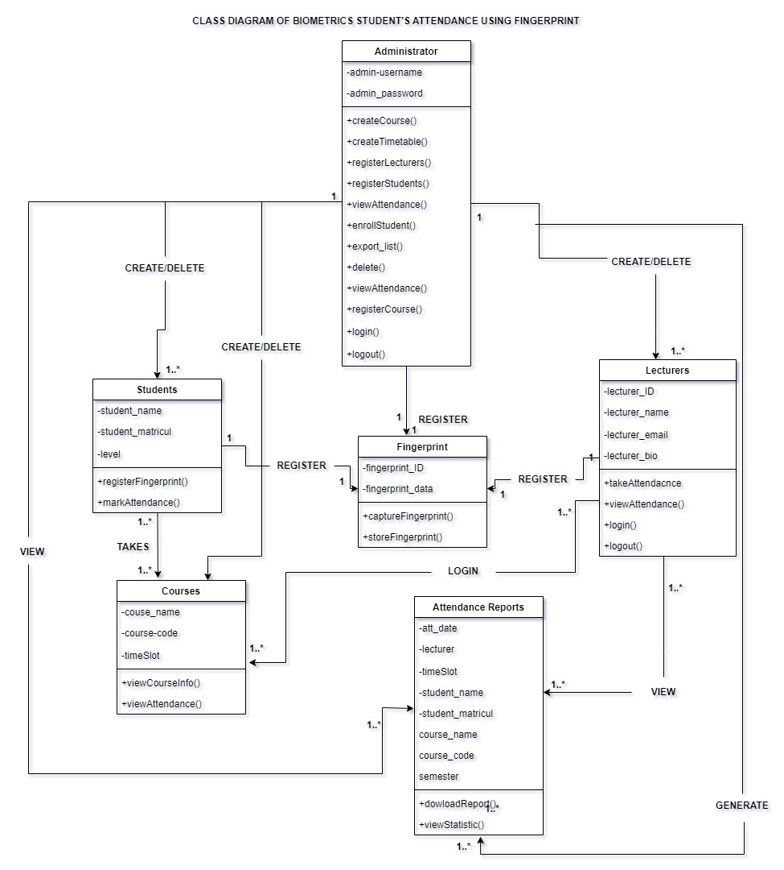
5 CLASS DIAGRAM

Slide 12
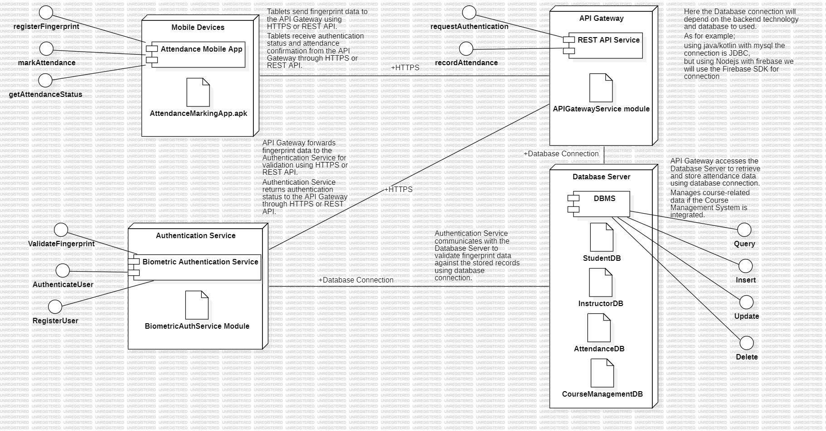
6.0 DEPLOYMENT DIAGRAM

Slide 13
7.0 CONCLUSION
With the system modeling and design phase complete, we have a clear and detailed architectural blueprint in place. This strong foundation is critical as we transition to the UI design phase, where we will focus on creating intuitive interfaces that align with our system's capabilities and objectives.

Slide 14


Thanks For Your Attention

